Slide 1


Detecting Malicious GitHub Accounts
Presented by -
Hamza Yousaf

Slide 2
Introduction to GitHub and Data Set
GitHub: It is a code hosting platform for version control(open source) and collaboration.
1. It helps individuals and groups work together from anywhere on projects
2. Majorly used for tracking code files.
Understanding the Given Dataset
1. The data set is of GitHub users which was partially created from Google public dataset.
2. We have information about accounts created in a single day on GitHub.
3. The number of accounts we have in this data are 3844.

Slide 3
Problem Statements
To identify malicious accounts created on GitHub
To identify patterns that indicates suspicious activity
To identify mass creation of accounts(via campaigns) controlled by single or group of actors.

Slide 4
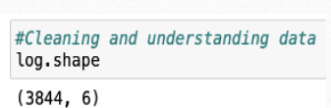
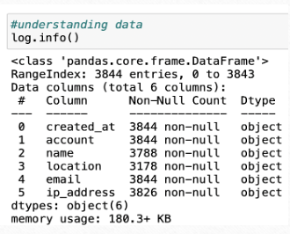
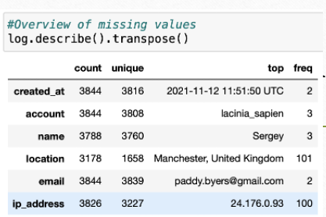
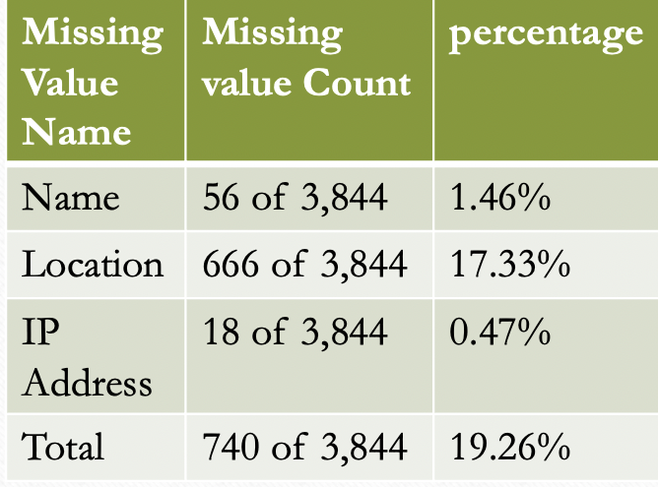
Data information
Shape
Info
Describe
Missing value

Slide 5
Data Analysis
Invalid names (Non- readable human names)
Invalid email
Invalid location
Mass creation of accounts with the same IP address
Valid email address used more than once
Fields | Validation Applied
Name | .isalpha(), which considers some symbol & all alphabets.
Email Address | Validate_email
Email Id | How many times has one email id being used
Location | .isalnum(), some ASCII codes
IP Address | Combining accounts created from same IP address & filtering accounts that were created in less than 3 min

Slide 6
Explaining Malicious/Non-Malicious Accounts
We have performed the following steps:
We have cleaned the data and understood its attributes
Understanding the data types and the business problem
Performing data analysis to address business problem
Final output.

Slide 7
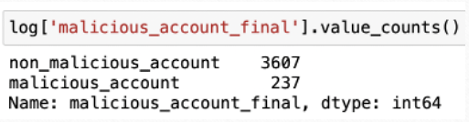
Explaining Malicious/Non-Malicious Accounts
We have drawn the following conclusion from our analysis as shown in the graph.
We have 237 malicious accounts
We have 3607 non- malicious accounts
We have taken the input from file account_log_without_labels.xlxs and the output is saved in the file accout_log_without_label_output.xlxs.

Slide 8
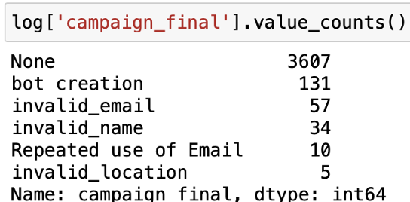
Explaining Campaign Names
Each malicious account identified are grouped into 5 campaign based on similar trend observed during our analysis. The 5 campaign names are mentioned in the below table.
Two primary malicious campaigns identified: bot creation and invalid emails, detected through automated 'IP address' and 'created at' columns, alongside mandatory email address fields.of them are presented in the graph.
We have grouped malicious accounts in campaign based on similar pattern and matrix. We also have our final count of malicious accounts in “malicious_account_final” column and campaign names in “campaign_final” column in our final output file.

Slide 9
Recommendation as an analyst
As per the data provided, we have noticed that the users in GitHub can create account with an already existing username. There are 68 of such instances.
Implement a username uniqueness check to prevent account name duplication.
Enhance email validation to detect and block invalid email formats.
Introduce rate-limiting to prevent mass account creation from single IPs.
Apply more complex pattern recognition to identify non-human account names.
Regularly update detection algorithms to adapt to evolving malicious strategies.
Consider user behavior analytics for deeper insight into account activities.

